Slide 1
Project 'Novel Contribution', 'Work by Competitors', 'Data', and 'Method'
By Vivek Pandiyan

Slide 2
Novel Contribution
In the course of the last three years, our climate items have been delivered on an every day basis, gradually enhancing as we create different parts of the framework.
By and by we make every day conjectures, up to 48hours in span.
The previous decade has seen the blossoming of a few novel methods for climate figure check and measurements for atmosphere display assessment. In spite of being centered around tending to the requirements of particular (climate or atmosphere) applications, a large portion of these strategies can be imagined and adjusted to serve in a multidisciplinary setting. The commitments on factual methodologies for both climate and atmosphere show assessment (and related applications), with the trust of improving logical trade and cooperative energies between the climate and atmosphere groups.

Slide 3
Novel Contribution
Together researchers working both in the improvement and utilization of nonlinear strategies for the quantitative investigation and displaying of atmosphere extremes. Commitments can be either hypothetical (i.e. exhibiting new strategies) or connected (i.e. indicating entrenched strategies connected in an inventive route or to new informational indexes). Points of view and also survey studies are likewise welcome. Likewise of intrigue is the "cross-fertilization" of techniques used to break down extremes in different fields, for instance econometrics and other geophysical sciences.

Slide 4
Novel contribution
Lamentably, numerous sorts of changes, (for example, instrument and additionally spectator changes, and changes in station area and introduction, watching practices and method, and so forth.) that occurred in the time of information record could bring about non-climatic sudden changes (simulated movements) in the information time arrangement. Such simulated movements could impactsly affect the aftereffects of atmosphere examination, particularly those of atmosphere pattern investigation. Subsequently, counterfeit changes might be dispensed with, to the degree conceivable, from the time arrangement before its application, particularly its application in atmosphere patterns appraisal.

Slide 5
Novel contribution
Late methodological and reasonable advancements in measurable downscaling. We particularly welcome commitments tending to spatial-transient and multi-variable changeability (specifically of extraordinary occasions); the advancement of factual models for sub-every day fluctuation, for example, convective occasions; the joining of process comprehension into inclination revision techniques; the choice of indicators to catch environmental change; the execution and included benefit of downscaling strategies regular to centennial scales (counting the capacity to extrapolate past watched values); the improvement of process-based approval diagnostics for measurable downscaling; and the evaluation of favorable circumstances and intrinsic constraints of various methodologies.

Slide 6
Novel contribution
Progressed measurable techniques to assess climate and atmosphere extremes in atmosphere display recreations. The mix of atmosphere model reproductions with observational and reanalysis items requires creative examinations and measurements of execution that make utilization of data identified with procedures producing inside atmosphere changeability and opening up climate and atmosphere extremes. The sensitivities of model assessment results to the picked extremes list, reference dataset and considered locale are likely identified with model inadequacies in speaking to the spatio-fleeting attributes of physical procedures and input components pertinent to the event of extremes, both in the atmosphere models and in the climate estimating models utilized as a part of reanalyses. This session welcomes commitments that concentrate on the assessment of the reliance of the area, size, term and recurrence of extremes upon encompassing climatic conditions. This incorporates, for example, show assessment techniques that look at circulations instead of deterministic qualities and that can catch spatio-worldly attributes; commitments that examine established execution measurements for univariate extremes and stretch out univariate execution measurements to multivariate; and commitments that talk about ways to deal with survey weights to individual models inside substantial multi-display group systems.

Slide 7
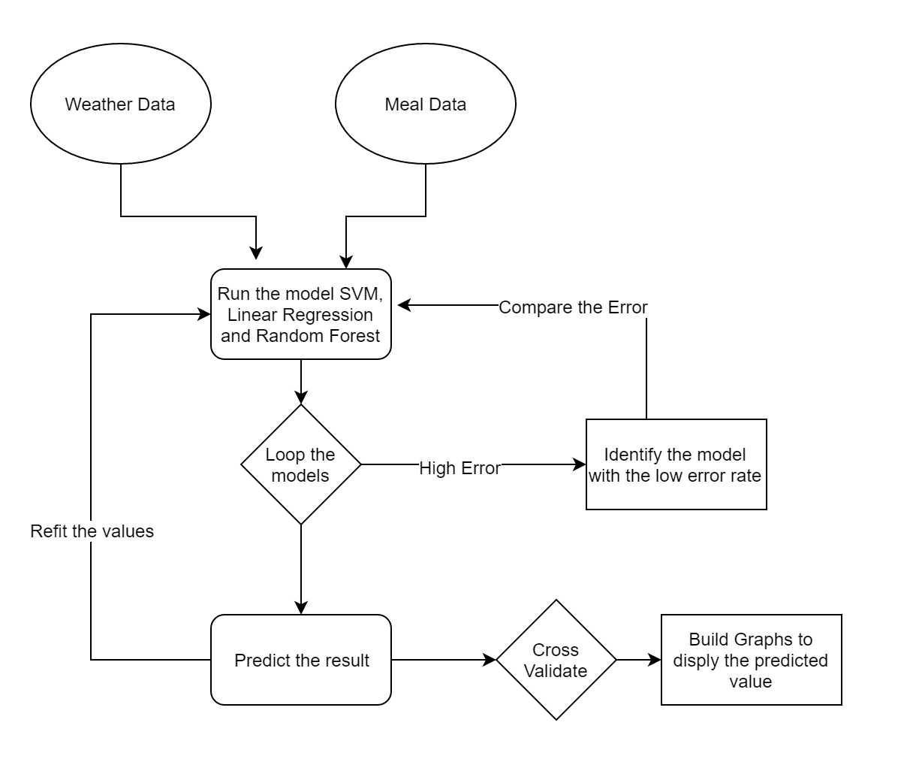
Flow Chart

Slide 8
Work by Competitors
Weather models very commonly used on a day-to-day basis. Using the past and the current weather data observed, forecast the future movement of the weather. Weather forecast concentrates on taking current perceptions of climate and handle these information with the help of computer models to calculate the future condition of climate. There are various factors affecting the change in weather few of which is as follows Temperature, Humidity, Pressure, Dew point, Wind speed, Wind direction, Visibility. All the above mentioned variables serve as input for the model.
Climate research plays a key role in understanding the challenge posed by climate and in developing the necessary solutions to benefit the environment, society and the business sector. The raise in the temperature causes global warming which in turn leads to the raise in the sea water level. The greenhouse effect or raise in the carbon di oxide also influences directly in the raise of global temperature. To predict the weather it is essential to identify all the factor influencing the changes.

Slide 9
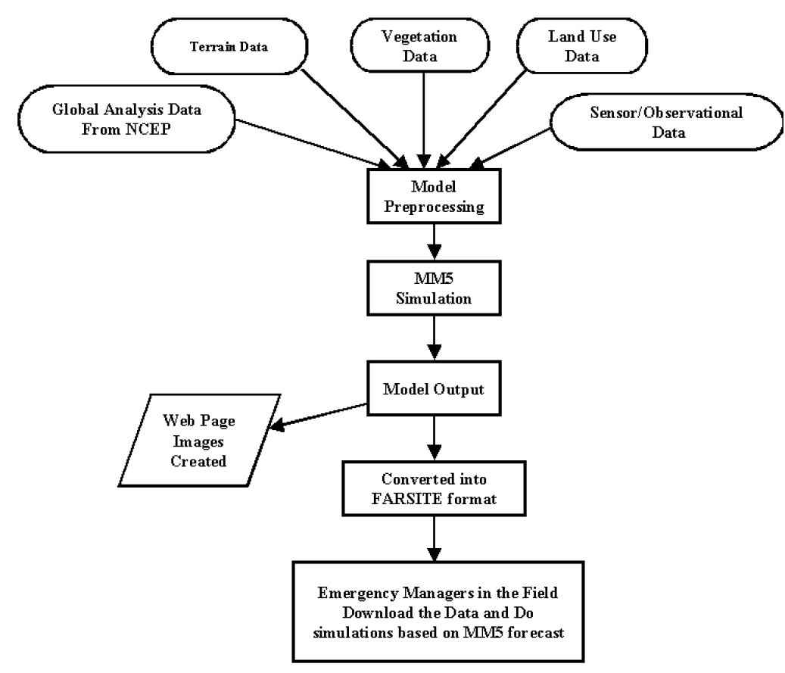
Flow Chart

Slide 10
Limitations
The data represents only 40% for worldwide vitality use. Therefore the data set can be skewed to some extent making a biased contribution.
Those diminish in the everyday temperature range is incompletely identified with builds.
An extensive number for climatic and surface limit states need aid demonstrated should differentially influence the greatest also base temperature.

Slide 11
Data
Temperature
Humidity
Pressure
Dew point
Wind speed
Wind direction
Visibility
Timestamp

Slide 12
Temperature
Earth is getting warmer; the cause could be human activity or natural variability. Since the beginning of the industrial revolution, it is observed as an evidence of risen temperature. Of course, the temperature fluctuates by many degrees everyday where we live, by accumulation of this fluctuation now had accrued and lead and to be in global warming.
Humidity
It tells the moisture content of the atmosphere. When the humidity is high it feels oppressive outside because of sweat doesn’t evaporate. When the humidity is low you feel cooler but moisture evaporated. The relative humidity is dependent on air temperature. If the water vapour content stays the same and the temperature drops the relative humidity increases.

Slide 13
Pressure
Pressure (symbol: p or P) is the force applied perpendicular to the surface of an object per unit area over which that force is distributed. Gauge pressure (also spelled gage pressure) is the pressure relative to the ambient pressure. Air gets lighter with increasing altitude
Dew Point
Dew point may drop by some possible influences; as when the temperature drops it’s enough to get fog and dew, water condenses out of the air and lowering the dew point. When it is hotter outside, the water will evaporate from the ground faster and the dew point raises. And when it is hottest outside, there is more wind and the mixing of low altitude and high altitude air lowers the dew point. Dew point is dependent on temperature. Dew point is a more reliable indicator of humidity because it is not changed by a change in air temperature and doesn’t fluctuate much throughout the day.

Slide 14
Wind Speed
Wind, which is as called as air movement, is integral to all types of weather conditions. Wind speed is caused by air moving from high pressure to low pressure, usually due to changes in temperature. Wind speed is influenced by various elements and circumstances, working on shifting scales (from smaller scale to full scale scales). There are likewise connections to be found between wind speed and wind course, strikingly with the weight inclination and landscape conditions.
Wind Direction
Wind direction is obtained by the direction from which it initiates. For example a wind coming from the south is shown as 180 degrees and the one from the east is 90 degrees. Air pressure, which is largely caused by differential heating of the air by the sun and ground conditions, controls the way air flows. Instruments can be utilized to quantify wind direction, for example, the windsock or a wind vane. Both of these instruments work by moving on air resistance. The way a climate vane is pointed by winning winds demonstrates the direction of wind direction.

Slide 15
Visibility
Visibility is a measure of the distance at which an object or light can be clearly seen . visibility affects all forms of traffic, aviation and sailing. Visibility to transparency of air; in dark visibility still the same as in daylight for the same air. If the temperature is warm, the atmosphere has a greater capacity to hold water in its vaporous state than if it is cold. Vapour can change into visible water in one other way.
Timestamp
Timestamp records the time at which the values are recorded. It is of the form mm/dd/yyyy and it also provides the time at which the values are noted.

Slide 16
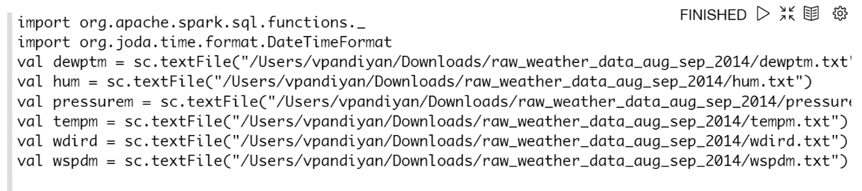
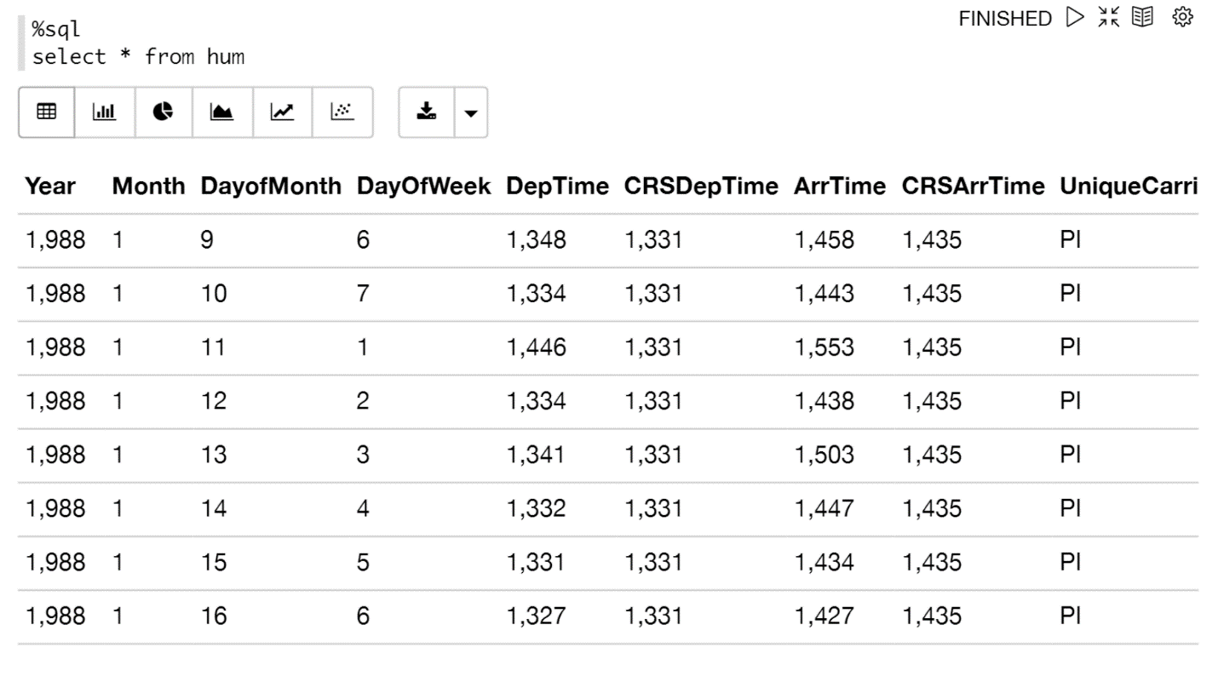
Data in Zeppelin

Slide 17
Method
Linear Regression
Support Vector Machine(SVM)
Random Forest

Slide 18
Linear Regression
Simple straight relapse is a measurable method that permits us to summarize and examine connections between two persistent (quantitative) factors.
Simple straight relapse is a factual method that permits us to summarize and ponder connections between two consistent (quantitative) factors:
One variable, denoted x, is viewed as the indicator, illustrative, or free factor.
The other variable, denoted y, is viewed as the reaction, outcome, or ward variable.
Since alternate terms are utilized less every now and again today, we'll utilize the "indicator" and "reaction" terms to allude to the factors experienced in this course. Alternate terms are mentioned just to make you mindful of them should you experience them in different fields. Simple direct relapse gets its descriptor "simple," since it concerns the investigation of just a single indicator variable. Interestingly, multiple direct relapse, which we concentrate later in this course, gets its descriptor "multiple," on the grounds that it concerns the investigation of two or more indicator factors.

Slide 19
Support Vector Machine(SVM)
Bolster Vector Machine" (SVM) is an administered machine learning algorithm which can be utilized for both characterization or relapse challenges. we plot every information item as a point in n-dimensional space (where n is number of components you have) with the estimation of each element being the estimation of a specific organize.
Pros:
It works truly well with clear margin of division
It is powerful in high dimensional spaces.
It is powerful in situations where number of dimensions is more prominent than the number of samples.
It utilizes a subset of preparing focuses in the choice capacity (called bolster vectors), so it is likewise memory productive.
Cons:
It doesn't perform well, when we have substantial informational collection in light of the fact that the required preparing time is higher

Slide 20
Random Forest
Random forests or random decision forests are an ensemble learning method for classification, regression and other tasks, that operate by constructing a multitude of decision trees at training time and outputting the class that is the mode of the classes (classification) or mean prediction (regression) of the individual trees. Random decision forests correct for decision trees' habit of overfitting to their training set.
The first algorithm for random decision forests was created by Tin Kam Ho using the random subspace method
Components of Random Forests
It is unexcelled in precision among current algorithms.
It runs productively on huge information bases.
It can deal with a large number of information factors without variable cancellation.
It gives estimates of what factors are important in the order.

Slide 21
References
Spencer, Matthew, et al. "Executing multiple pipelined data analysis operations in the grid." Proceedings of the 2002 ACM/IEEE conference on Supercomputing. IEEE Computer Society Press, 2002.
Kim, Hwi-Gang, Seongjoo Lee, and Sunghyon Kyeong. "Discovering hot topics using Twitter streaming data social topic detection and geographic clustering." Advances in Social Networks Analysis and Mining (ASONAM), 2013 IEEE/ACM International Conference on. IEEE, 2013.
Buneci, Emma S., and Daniel A. Reed. "Analysis of application heartbeats: Learning structural and temporal features in time series data for identification of performance problems." Proceedings of the 2008 ACM/IEEE conference on Supercomputing. IEEE Press, 2008.
Wolski, Rich, Neil Spring, and Chris Peterson. "Implementing a performance forecasting system for metacomputing the network weather service." Supercomputing, ACM/IEEE 1997 Conference. IEEE, 1997.
Roe, Kevin, Duane Stevens, and Carol McCord. "High resolution weather modeling for improved fire management." Proceedings of the 2001 ACM/IEEE Conference on Supercomputing. ACM, 2001.
James Stephen, Julian, et al. "Program analysis for secure big data processing." Proceedings of the 29th ACM/IEEE international conference on Automated software engineering. ACM, 2014.
Swany, Martin, and Rich Wolski. "Multivariate resource performance forecasting in the network weather service." Supercomputing, ACM/IEEE 2002 Conference. IEEE, 2002.
Primet, Pascale, Robert Harakaly, and Franck Bonnassieux. "Experiments of network throughput measurement and forecasting using the network weather." Cluster Computing and the Grid, 2002. 2nd IEEE/ACM International Symposium on. IEEE, 2002.
Cheng, Shanjun, Anita Raja, and Victor Lesser. "Multiagent meta-level control for a network of weather radars." Web Intelligence and Intelligent Agent Technology (WI-IAT), 2010 IEEE/WIC/ACM International Conference on. Vol. 2. IEEE, 2010.
Roe, Kevin, Duane Stevens, and Carol McCord. "High resolution weather modeling for improved fire management." Proceedings of the 2001 ACM/IEEE Conference on Supercomputing. ACM, 2001.

